Slide 1











Introduction to
Algorithm Design and Analysis
[8] logn search
Yu Huang
http://cs.nju.edu.cn/yuhuang Institute of Computer Software Nanjing University

Slide 2

In the last class…
Selection – warm up
Max and min
Second largest
Selection – Rank k (median)
Expected linear time
Worst-case linear time
Adversary argument
Lower bound

Slide 3


logn search
Essential of the searching problem
How to organize the data to enable efficient search
o logn search
Each search cuts off half of the search space
How to organize the data to enable logn search
logn search techniques
Binary search over sorted sequences
Balanced Binary Search Tree (BST)

Slide 4






Binary Search by Example
Binary search for “24”
Divide the search space
Cut off half the space after each search
The sequence is already sorted
₁st ₃rd
₂nd
3 | 5 | 6 | 20 | 21 | 24 | 30 | 40 | 45 | 50
Pseudo code in
p.129 [Baase01]

Slide 5

Balanced Binary Search Tree
Binary search tree (BST)
Definitions and basic operations
Definition of Red-Black Tree (RBT)
Black height
RBT operations
Insertion into a red-black tree
Deletion from a red-black tree

Slide 6










Binary Search Tree Revisited
Good balancing
Θ(logn)
Poor balancing
Θ(n)
40
30
20
60
80
20
30
50
80
60
In a properly drawn tree, pushing forward to get the ordered list.
40
50
Each node has a key, belonging to a linear ordered set
An inorder traversal produces a sorted list of the keys

Slide 7



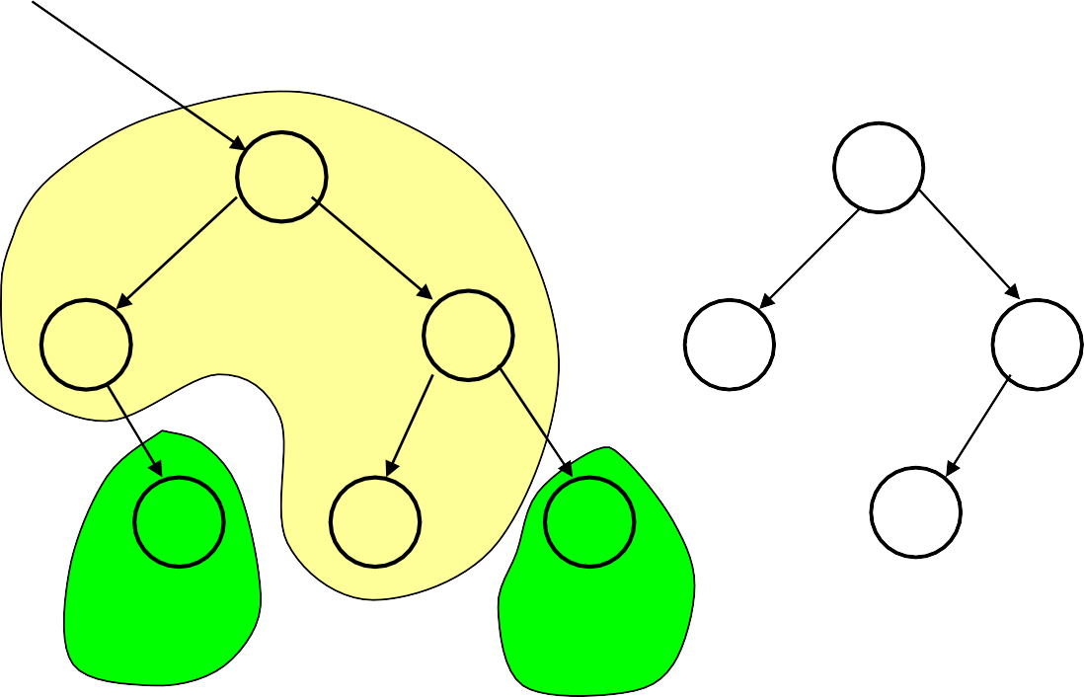











Node Group
As in 2-tree, the number of external node is one more than that of internal node
Node group
50
70
70
15
25
60
80
60
80
10
20
40
65
75
90
75
30
5 principal subtrees

Slide 8





Balancing by Rotation
The node group to be rotated
50
50
25
Root of the group is changed.
15
15
40
10
25
10
20
30
20
40
30
The middle principal subtree changes parent

Slide 9






Red-Black Tree: the Definition
If T is a binary tree in which each node has a color, red or black, and all external nodes are black, then T is a red-black tree if and only if:
[Color constraint] No red node has a red child
[Black height constraint] The black length of all external paths from a given node u is the same (the black height of u)
o The root is black.
Almost-red-black tree(ARB tree)
Balancing is under control
o Root is red, satisfying the other constraints.

Slide 10


Recursive Definition of RBT
(A red-black tree of black height h is denoted as RB_{h})
Definition:
o An external node is an RB₀ tree, and the node is black.
o A binary tree is an ARB_{h} (h≥1) tree if:
No ARB₀
Its root is red, and
Its left and right subtrees are each an RB_{h-1} tree.
A binary tree is an RB_{h} (h≥1) tree if:
Its root is black, and
Its left and right subtrees are each either an RB_{h-1} tree or an
ARB_{h} tree.

Slide 11




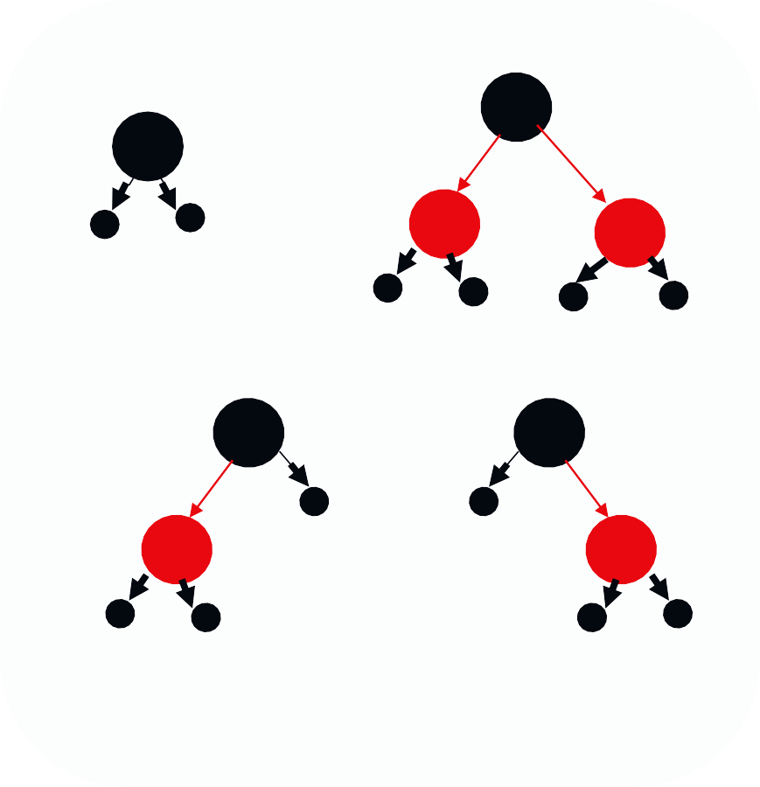


RB_{i} and ARB_{i}
RB₀
(1)
(2)
ARB₁
(3)
(4)
RB₁

Slide 12














Red-Black Tree with 6 Nodes
40
20
60
poorest balancing:
30 height(normal) is 4
30
50
80
20
60
Black edge
40
50
80
20
60
40
30
50
80

Slide 13





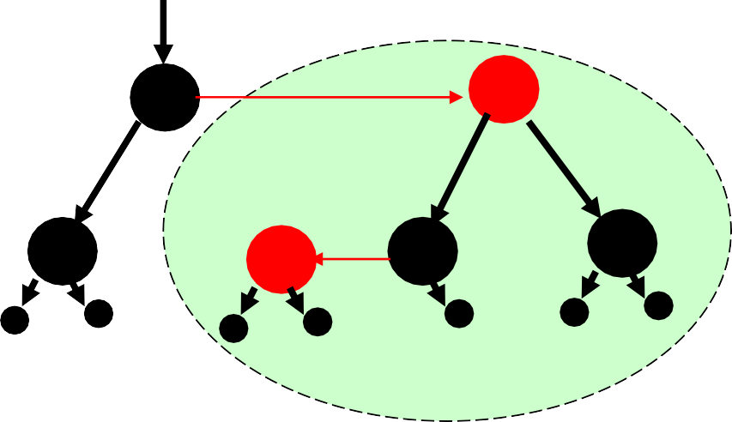

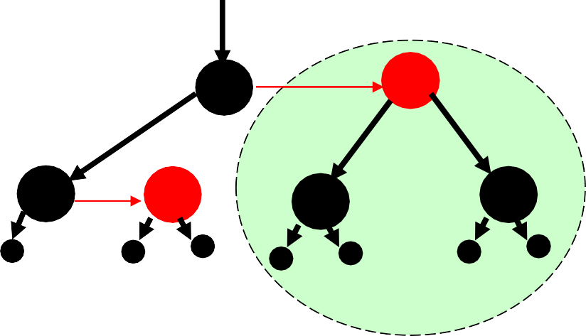


Black-depth Convention
All with the same largest black depth: 2
40
20 ₃₀
50
60 80
30
60
20
40
50
80
40
60
20
30
50
80
ARB Trees

Slide 14


Properties of Red-Black Tree
The black height of any RB_{h} tree or ARB_{h} tree is well-defind and is h.
Let T be an RB_{h} tree, then:
T has at least 2^{h}-1 internal black nodes.
T has at most 4^{h}-1 internal nodes.
The depth of any black node is at most twice its black depth.
Let A be an ARB_{h} tree, then:
A has at least 2^{h}-2 internal black nodes.
A has at most (4^{h})/2-1 internal nodes.
The depth of any black node is at most twice its black depth.

Slide 15


Well-Defined Black Height
That “the black height of any RB_{h} tree or ARB_{h} tree is well defind” means the black length of all external paths from the root is the same.
Proof: induction on h
Base case: h=0, that is RB₀ (there is no ARB₀)
In ARB_{h+1}, its two subtrees are both RB_{h}. Since the root is red, the black length of all external paths from the root is h, that’s the same as its two subtrees.
In RB_{h+1}:
Case 1: two subtrees are RB_{h}’s
Case 2: two subtrees are ARB_{h+1}’s
Case 3: one subtree is an RB_{h}(black height=h), and the another is an ARB_{h+1}(black height=h+1)

Slide 16



Bound on Depth of Node in RBTree
Let T be a red-black tree with n internal nodes. Then no node has black depth greater than 2log(n+1), which means that the height of T in the usual sense is at most 2log(n+1).
Proof:
Let h be the black height of T. The number of internal nodes, n, is at least the number of internal black nodes, which is at least 2^{h}-1, so h≤log(n+1). The node with greatest depth is some external node. All external nodes are with black depth h. So, the depth is at most 2h.

Slide 17






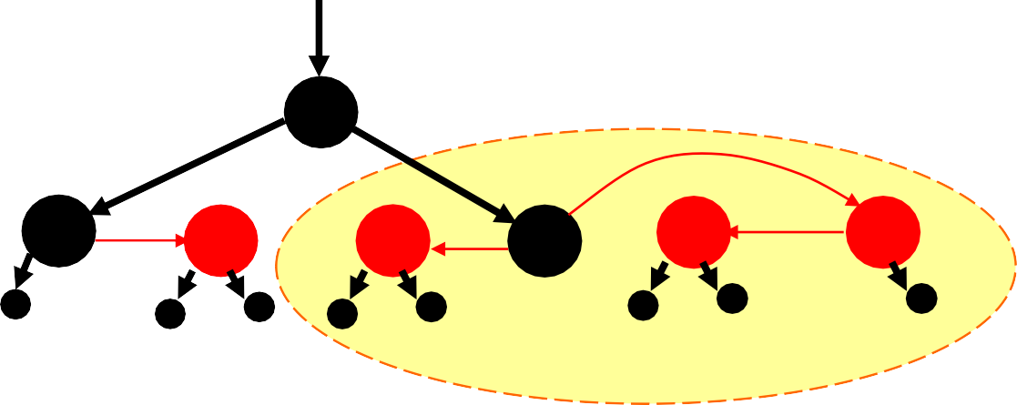


Influences of Insertion to an RBT
Black height constraint:
o No violation if inserting a red node.
Color constraint:
Critical clusters(external nodes excluded), which originated by color violation, with 3 or 4 red nodes
40
20 ₃₀
50
60 80
40
Inserting 70
20
30
50
60 70
80

Slide 18









Repairing 4-node Critical Cluster
40
No new critical cluster occurs, inserting finished.
20
30
50
60 70
80
Color flip:
Root of the critical cluster exchanges color with its subtrees
40
60
20 ₃₀
50
70
80

Slide 19
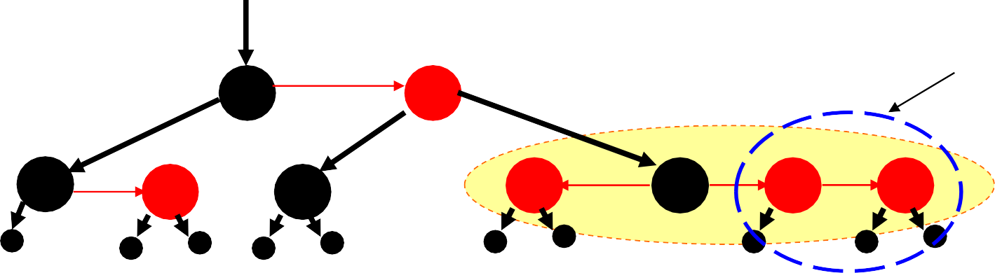


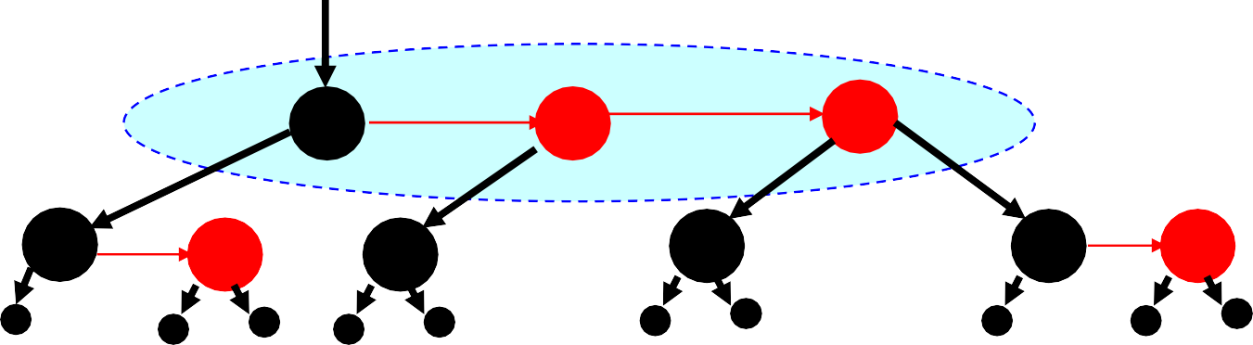
Repairing 4-node Critical Cluster
2 more insertions
40
60
Critical cluster
80 85
20
30
50
70
90
New critical cluster with 3 nodes.
Color flip doesn’t work, Why?
40
60
80
20
30
50
70
85
90

Slide 20



Patterns of 3-node Critical Cluster
B
A
L
M R
L
M R
LL
LR
RL
RR
LL
LR
RL
RR
Shown as properly drawn
C
D
L
M R
L
M R
LL
LR
RL
RR
LL
LR
RL
RR

Slide 21





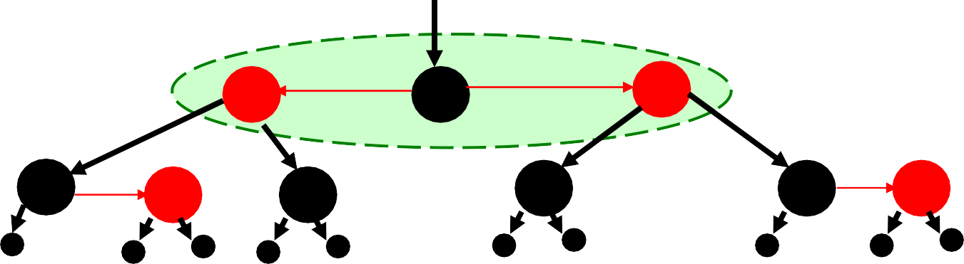
Repairing 3-Node Critical Cluster
All into one pattern
Root of the critical cluster is changed to M, and the parentship is adjusted accordingly
L
M R
LL
LR
RL
RR
The incurred critical cluster is of pattern A
40
60
80
20
30
50
70
85
90

Slide 22


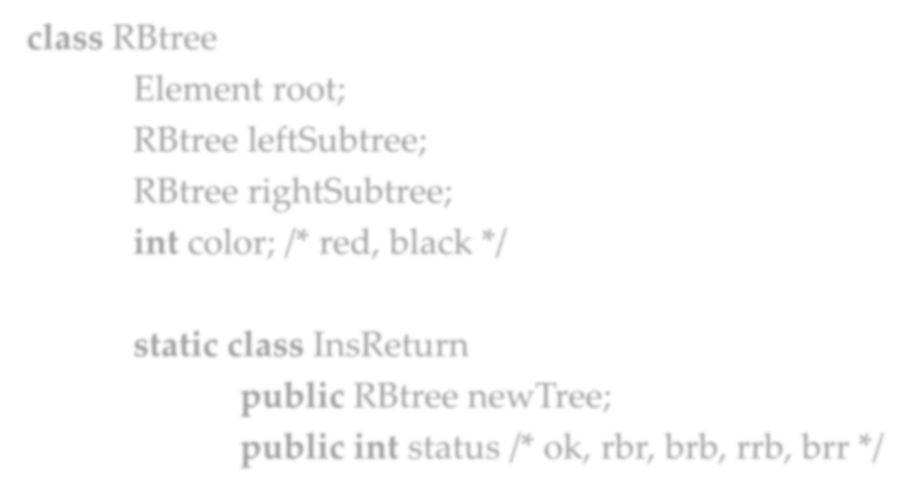


Implementing Insertion: Class
class RBtree
Element root; RBtree leftSubtree; RBtree rightSubtree;
int color; /* red, black */
static class InsReturn
public RBtree newTree;
Color pattern
public int status /* ok, rbr, brb, rrb, brr */

Slide 23

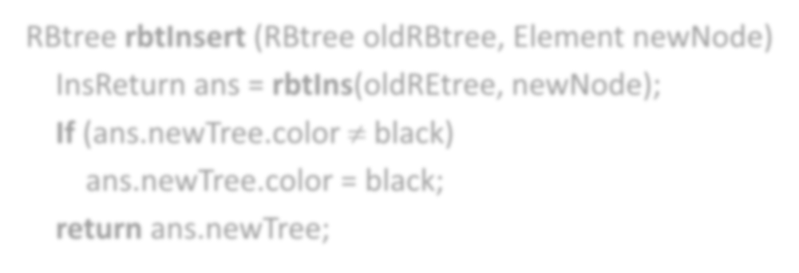


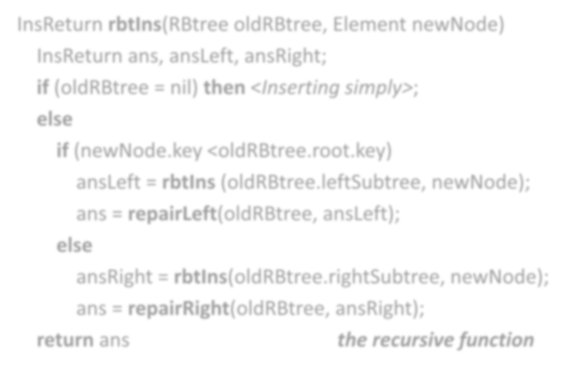


Implementing Insertion: Procedure
RBtree rbtInsert (RBtree oldRBtree, Element newNode)
^{InsReturn ans} I⁼ns^{r}R^{b}e^{tI}t^{n}u^{s}r⁽n^{ol}r^{d}b^{R}tIEn^{t}s^{re}(R^{e}B, t^{n}re^{w}e ^{N}olºd^{d}R^{e}B⁾t;ree, Element newNode)
^{If (ans.newTree.c}Inºs^{lo}R^{r}et≠u^{b}rn^{la}a^{c}n^{k)}s, ansLeft, ansRight; ^{ans.newTree.c}iºf ^{l}(ºo^{r}ld⁼R^{b}B^{l}tªr^{c}e^{k}e; = nil) then <Inserting simply>;
return ans.newT_{e}re_{ls}e_{e};
the wrapper
if (newNode.key <oldRBtree.root.key)
ansLeft = rbtIns (oldRBtree.leftSubtree, newNode); ans = repairLeft(oldRBtree, ansLeft);
else
ansRight = rbtIns(oldRBtree.rightSubtree, newNode); ans = repairRight(oldRBtree, ansRight);
return ans the recursive function

Slide 24

Correctness of Insertion
If the parameter oldRBtree of rbtIns is an RB_{h} tree or an ARB_{h+1} tree(which is true for the recursive calls on rbtIns), then the newTree and status fields returned are one of the following combinations:
Status=ok, and newTree is an RB_{h} or an ARB_{h+1} tree,
Status=rbr, and newTree is an RB_{h},
Status=brb, and newTree is an ARB_{h+1} tree,
Status=rrb, and newTree.color=red, newTree.leftSubtree is an ARB_{h+1} tree and newTree.rightSubtree is an RB_{h} tree,
Status=brr, and newTree.color=red, newTree.rightSubtree is an ARB_{h+1} tree and newTree.leftSubtree is an RB_{h} tree
For those cases with red root, the color will be changed to black, with other constraints satisfied by repairing subroutines.

Slide 25





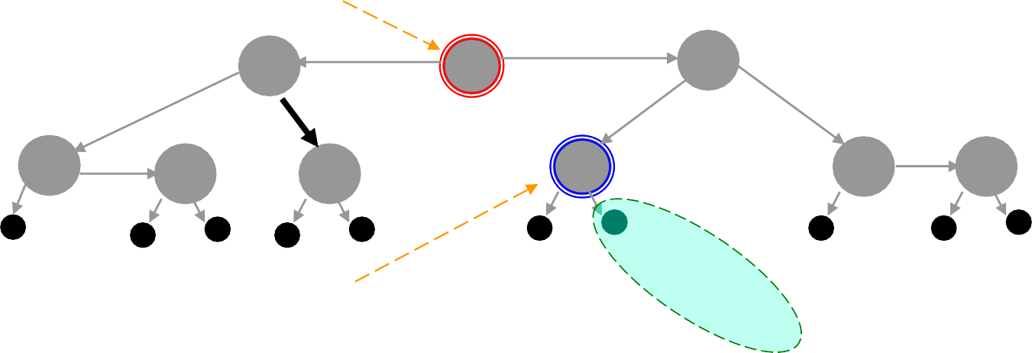




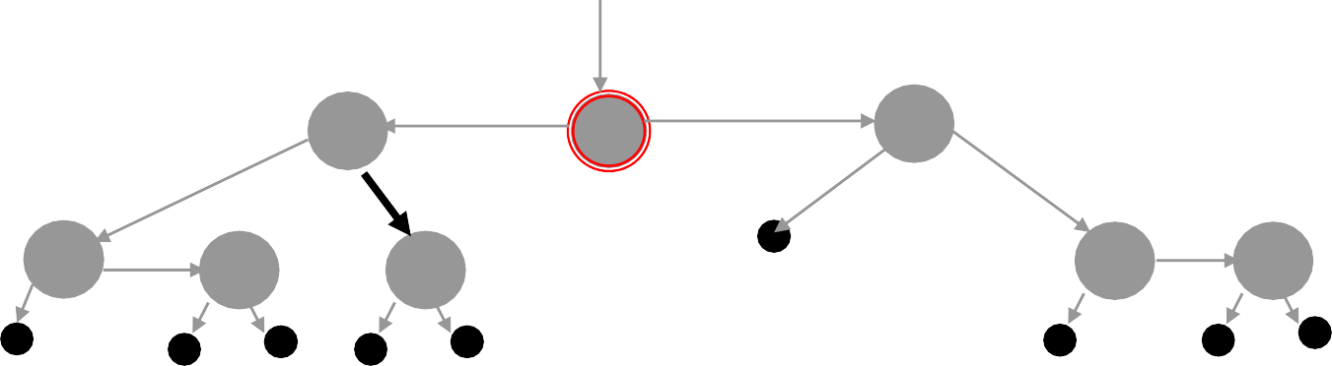
Deletion: Logical and Structural
u: to be deleted logically
π is parent of σ
π
80
40
60
20
30
50
70
85
90
σ: tree successor of u, to be deleted structurally, with information moved into u
S
right subtree of S, to replace S
π
80
40
70
20
30
50
85
90
After deletion

Slide 26




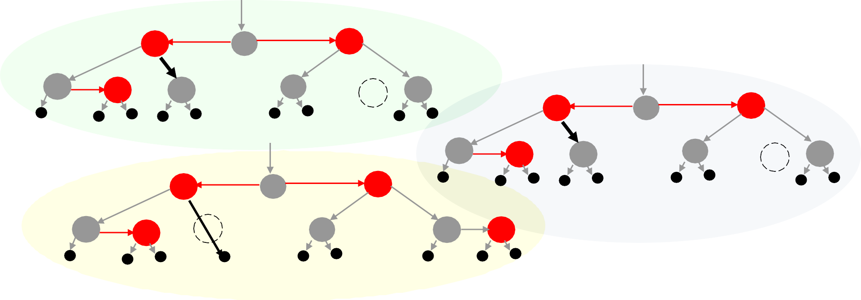
Deletion from RBT - Examples
Original tree
40
60
80
20 ₃₀
50
70
85
90
u,π
40
60
85
20
30
50
70
80
90
40
60
80
u,π
90
20
30
50
70
85
u,π
50
60
80
20
30
40
70
85
90

Slide 27



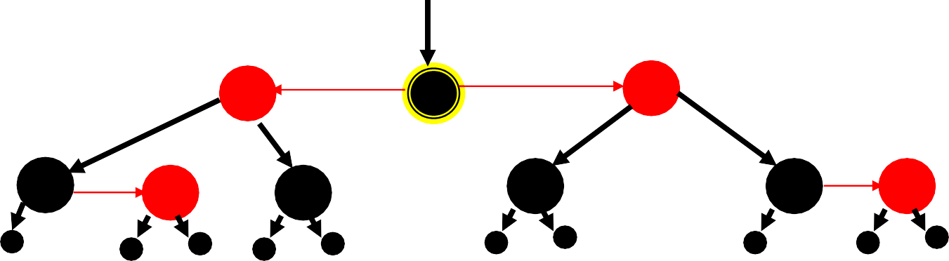




Deletion in RBT
To be deleted
40
60
80
20
30
50
70
85
90
one deletion
The black height of π
is not well-defined !
π
80
40
70
20 ₃₀
50
black depth=1
85 90
black depth=2

Slide 28



Procedure of Red-Black Deletion
Do a standard BST search to locate the node to be logically deleted, call it u
If the right child of u is an external node, identify u as the node to be structurally deleted.
If the right child of u is an internal node, find the tree successor of u , call it σ, copy the key and information from σ to u. (color of u not changed) Identify σ as the node to be deleted structurally.
Carry out the structural deletion and repair any imbalance of black height.

Slide 29

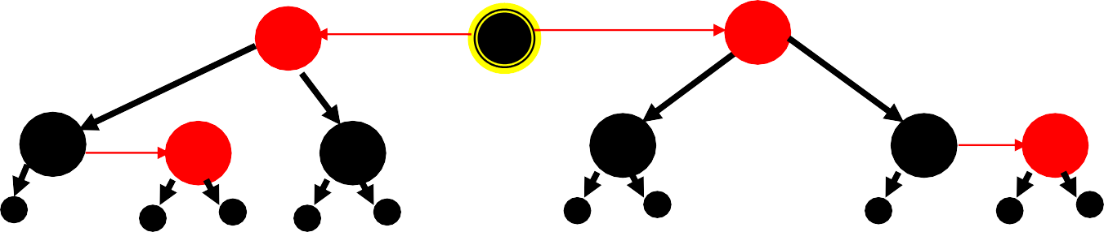




Imbalance of Black Height
40
60
80
20
30
50
70
85
90
deleting 80
85
deleting 40
50
Black height has to be restored
90
20 ₃₀
70
deleting 60
80 deleting 85
70
80
90
85
90

Slide 30

Analysis of Black Imbalance
The imbalance occurs when:
A black node is deleted structurally, and
Its right subtree is black (external)
The result is:
An RB_{h-1} occupies the position of an RB_{h} as required by its parent, coloring it as a “gray” node.
Solution:
Find a red node and turn it black as locally as possible.
The gray color might propagate up the tree.

Slide 31





Propagation of Gray Node
The pattern for
p
which propagation is needed
p
g
s
g
s
l
r
l
r
Gray Up
In the worst case, up to the root of the tree, and successful
r
Map of the vicinity of
g, the gray node
p
s
g-subtree gets well-defined black height, but that is less than that required by its parent
g
l

Slide 32







Repairing without Propagation
Deletion
p
Rebalance group
l s
Restructured
g
a
b
r
4 principal subtrees, RB_{h-1}
l
RB₂
p
s
Restructuring the deletion rebalance group:
Red p: form an RB₁ or ARB₂ tree
Black p: form an RB₂ tree
g
a
b
r

Slide 33

Repairing without Propagation
Deletion
p
Rebalance group
l s
Restructured
g
a
b
r
4 principal subtrees, RB_{h-1}
l
ARB₂
p
s
Restructuring the deletion rebalance group:
Red p: form an RB₁ or ARB₂ tree
Black p: form an RB₂ tree
g
a
b
r

Slide 34



Complexity of Operations on RBT
With reasonable implementation
A new node can be inserted correctly in a red-black tree with n nodes in Θ(logn) time in the worst case.
Repairs for deletion do O(1) structural changes, but may do O(logn) color changes.

Slide 35




Thank you!
Q & A
Yu Huang
http://cs.nju.edu.cn/yuhuang

